Slide 1
Final Project
Workshop in Computational Analysis of the Microbiome
Spring 2026

Slide 2
Agenda
Project description
Project data
Submission guidelines
Milestones
Evaluation

Slide 3
Agenda
Project description
Project data
Submission guidelines
Milestones
Evaluation

Slide 4
Goal
Find the combined microbiome-metabolome distance between samples with missing omics data

Slide 5
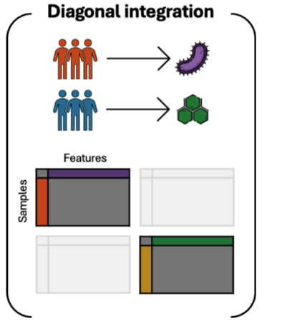
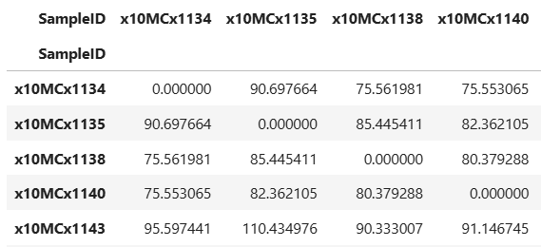
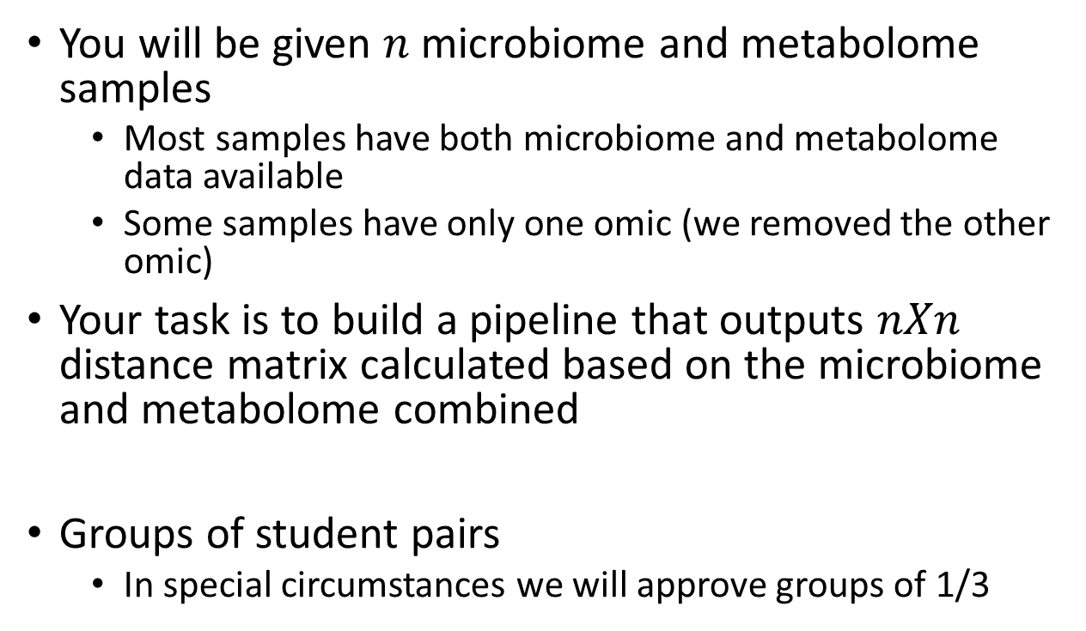
Description
You will be given $n$ microbiome and metabolome samples
Most samples have both microbiome and metabolome data available
Some samples have only one omic (we removed the other omic)
Your task is to build a pipeline that outputs $nXn$ distance matrix calculated based on the microbiome and metabolome combined
Groups of student pairs
In special circumstances we will approve groups of 1/3

Slide 6
Naïve solutions
Impute the missing omic data
KNN
Random forest
Naïve statistic – average, median, etc..
Use the imputed data to calculate the distance

Slide 7
Agenda
Project description
Project data
Submission guidelines
Milestones
Evaluation

Slide 8
Data – General Description
You will use the MetaCardis cohort
A large-scale multi-omic study.
Aims to identify novel microbial and metabolomic biomarkers for ischemic heart disease
Includes healthy individuals, individuals with dysmetabolic morbidities, and individuals with heart disease
three states (Denmark, Germany, and France).
For more information on the cohort and its main finding, it is advisable to read its two main papers (in Moodle)
Before the final submission you will receive two additional datasets for validation purposes

Slide 9
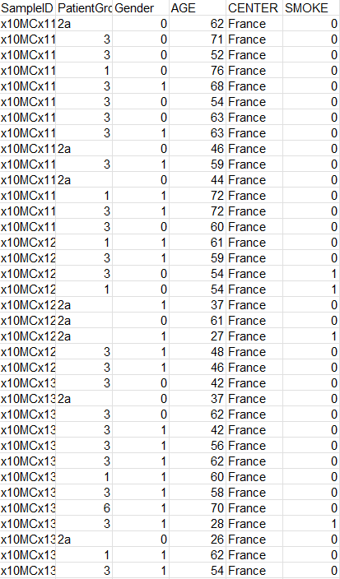
MetaCardis - Metadata
Metadata
general info and lifestyle data on each participant
Some patients may have missing values
all patients have PatientGroup and CENTER information

Slide 10
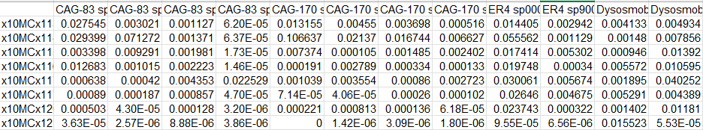
Stool Metagenomic Data
Taxonomical data
Relative abundance transformation on the abundance of microbial species in each subject
Rare taxa are filtered
Species level
For higher taxonomy\phylogenetic tree – contact us!

Slide 11
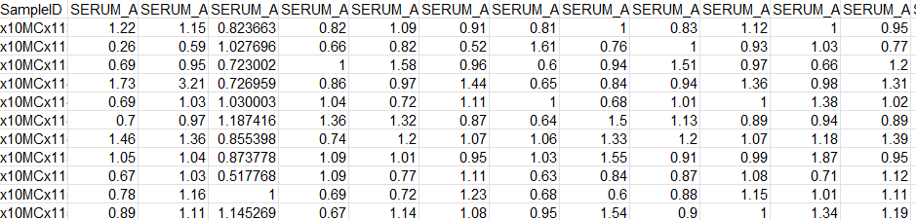
Data - Metabolomics
Serum metabolomics

Slide 12
Agenda
Project description
Project data
Submission guidelines
Milestones
Evaluation

Slide 13
Final Submission
A detailed pdf document describing the problem, the pipeline, validation and validation results and possible future directions
In a form of a scientific paper
4-5 pages at most
Adding figures (using matplotlib\seaborn\plotly etc…) is strongly encouraged
Code (Github link is ok)

Slide 14
Agenda
Project description
Project data
Submission guidelines
Milestones
Evaluation

Slide 15
Milestones
Three milestones during the course
Coordinating via email
An opportunity for group discussions
A short presentation that summarizes your progress and plans
Please send the presentations in advance
We will be happy to conduct more meetings according to your requests and needs

Slide 16
Milestone 1
Deadline 1/7
Ideas for the ML pipeline (preprocessing, ML models, evaluation plan)
Including an overview of the computational method or a concept you choose to explore
Based on a computational\computational biology paper\blog post
Any stage of the pipeline
In Moodle:
options and ideas
Guiding questions
preliminary exploration results if relevant
Only meaningful results, i.e.:
If it is relevant to your pipeline and ideas
Any problems you think you need to handle
See guidelines in Moodle
Naïve modeling as a benchmark
Predicting missing omics using KNN\RF
Evaluation:
Mask and recover
How good is predicting disease state with\without imputation?

Slide 17
Milestone 2
deadline 10/9
Presenting the pipeline
Preliminary pipeline results
Evaluation
Comparison to milestone 1 naïve modeling (performance and running time)
How the missing data percentage effects the pipeline performance?

Slide 18
Milestone 3
deadline 15/10
Presenting the final results (pipeline, validation and possible future directions)
Before the meeting:
We will send you two additional microbiome-metabolome datasets
You will send us your results on the MetaCardis dataset, as well as the additional datasets – at least 3 days in advance
See guidelines in Moodle
We will present your pipeline results on our data

Slide 19
Agenda
Project description
Project data
Submission guidelines
Milestones
Evaluation

Slide 20
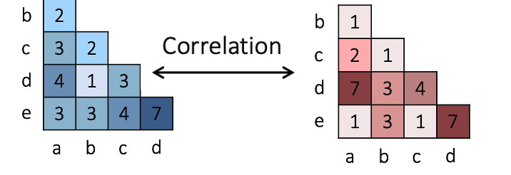
Evaluation
We construct a reference ("ground truth") distance matrix as follows:
Normalizing each microbiome and metabolome feature using standard scaler
Perform PCA on the combined normalized data
Calculate the Euclidean distances between samples in the first two principal components (2D PCA space)
We compare your predicted distance matrix to our ground truth matrix
Using a Mantel test between your predicted distance matrix and our ground truth distance matrix.

Slide 21
Final grade
Model performance
Milestone meetings
Overall quality of the final project
Creativity and research effort will be rewarded
Grades 96–100 are reserved for:
Exceptional effort
Innovative ideas
Particularly rigorous research
Creativity is preferred over pure performance
a highly creative and well-justified approach can be valued more than a marginal performance improvement
Meaningful, well-reasoned ideas, not arbitrary or unreasonable modifications

Slide 22
Questions?
Detailed instructions in Moodle

